Slide 1


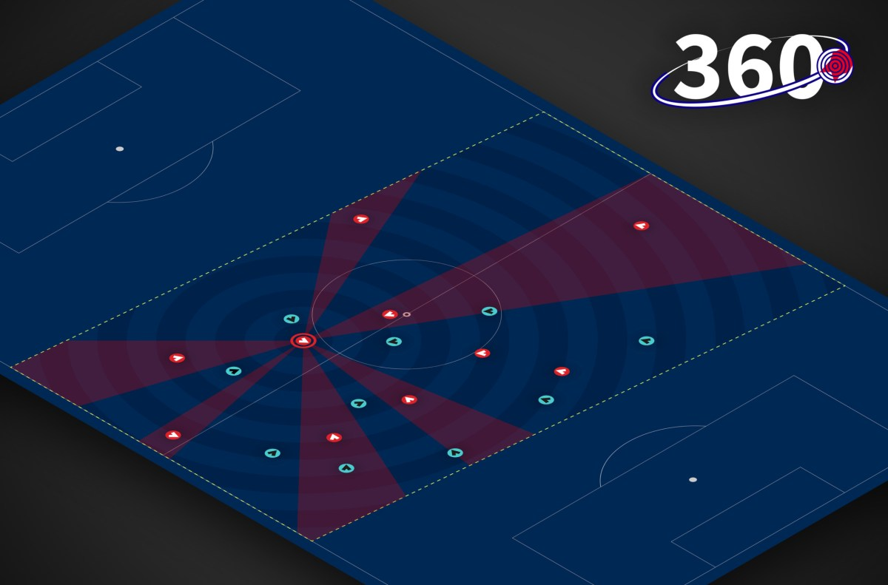
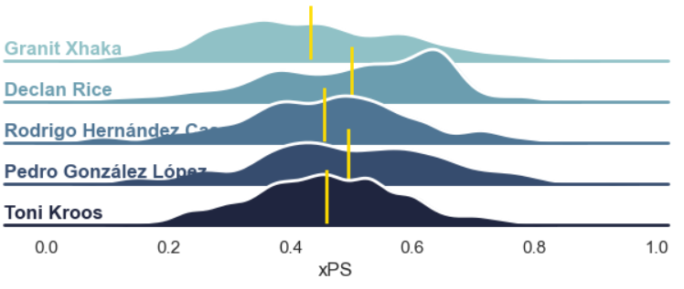
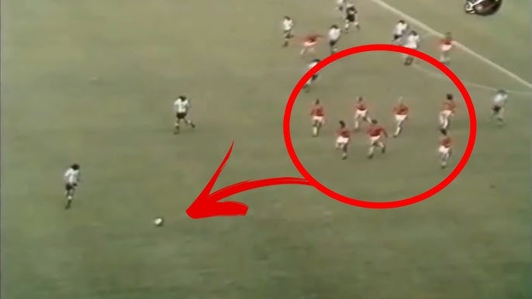
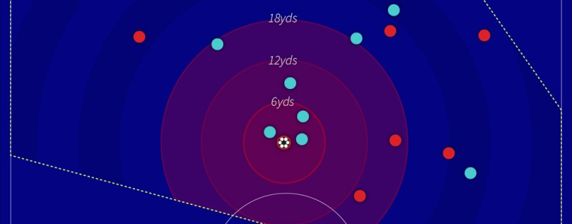
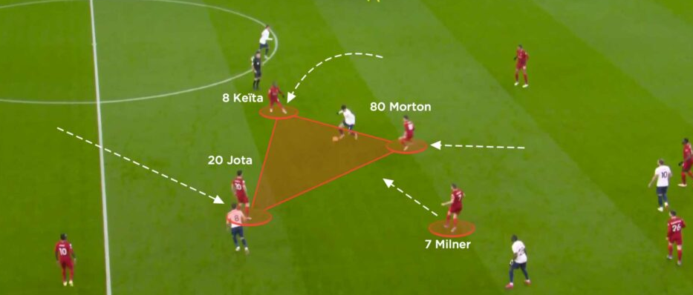

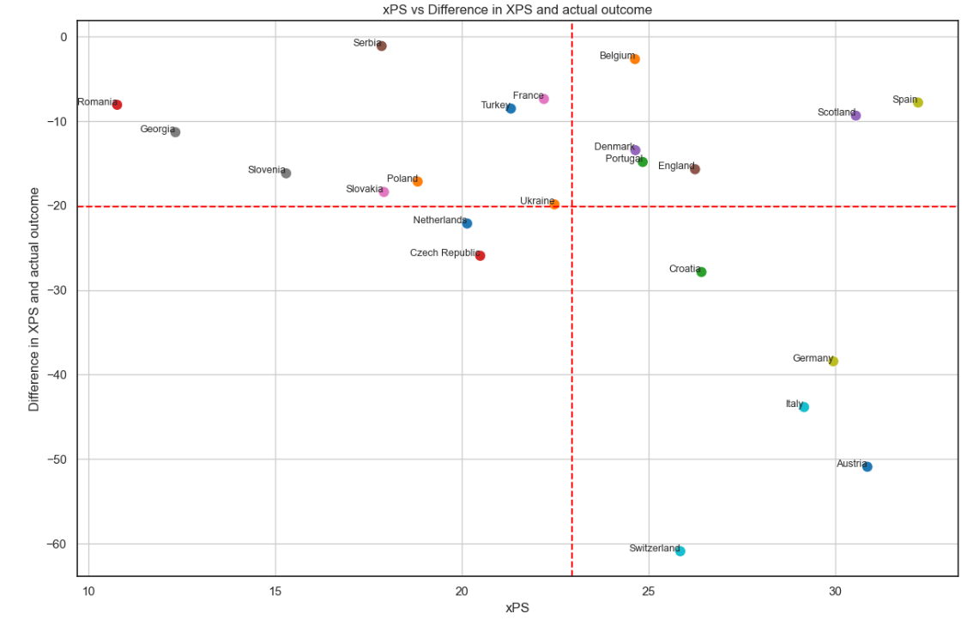
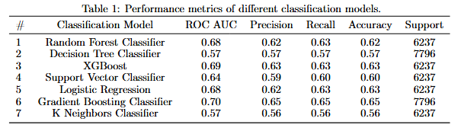
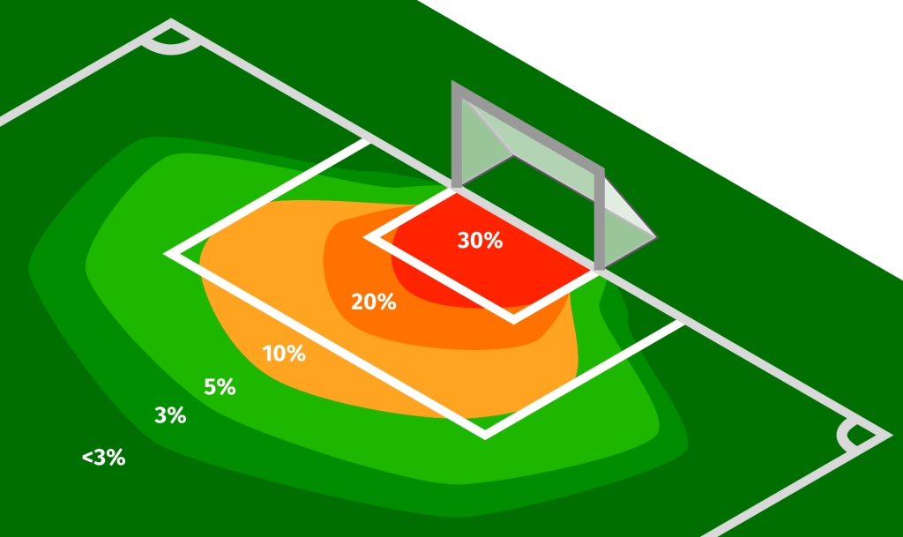
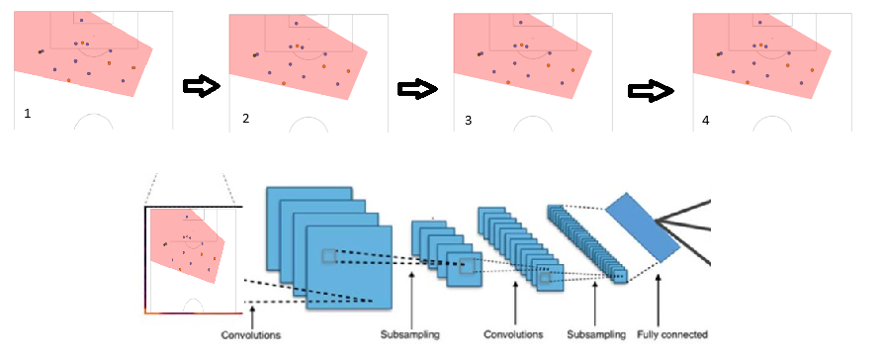
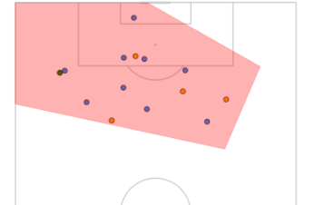
Expected Pressing Success (xPS)
¹J. Kakka, ¹P.Sunkavalli.
¹Master of Professional Studies – Data Analytics,, ⁵Penn State Great Valley School of Graduate Professional Studies, Penn State University, Malvern, PA 19355
WHAT IS PRESSING ?
USING EVENT DATA TO UNDERSTAND PRESSURE
EURO 2024 CASE STUDY
Pressing, a coordinated defensive strategy where a team collectively pressures the ball carrier to force mistakes and regain possession, has evolved significantly. Originating in 1934 with hockey coach Thomas Patrick Gorman, it was later adopted by Dutch teams in the 1970s under "Total Football." This approach, described by Dutch Manager Rinus Michels, involved all outfield players pressing forward even without the ball, creating a chaotic and dynamic style of play.
Our model utilizes event and 360 data from StatsBomb to analyze pressing success, adhering to top data standards. We trained on both open data and Euro 2024 datasets and conducted an in-depth case study focused on pressure situations. We tracked these situations using the ‘under_pressure’ field and categorized pass events as follows:
0: Backward passes, mistakes, or turnovers
1: Forward or line-breaking passes.
This classification enables us to gain valuable insights into pressing effectiveness and refine team strategies accordingly.
Incorporating 360 event data provides a holistic view of the field, encompassing not just the ball carrier but also teammates and opponents within the camera’s perspective. This data features precise X and Y coordinates for 8-12 players, allowing us to analyze player positioning, movement patterns, and spatial relationships. By capturing these dynamics, we can better understand how player positioning affects pressing strategies, offering deeper insights into tactical effectiveness and spatial awareness during matches.
The xPS metric helps identify players with low-pressing success. For the five most frequently pressed midfielders—Pedri, Rodri, Declan Rice, Toni Kroos, and Granit Xhaka—Granit Xhaka had the lowest xPS. This indicates that pressing him is less effective and unlikely to force backward passes or possession spillovers. This may explain his recent Ballon d'Or nomination and his role in Bayer Leverkusen’s invincible season.
Today, pressing has evolved into a more organized and strategic method. Modern variations, such as high block, low block, and Gegenpressing, showcase a structured approach that enables teams to reclaim possession through disciplined and well-coordinated efforts.
FUTURE IMPLICATIONS
PREDICTING WHEN TO TRIGGER A PRESS
Talent Identification: Spot players with essential pressing attributes and tailor training to enhance pressing skills.
Tactical Gaps: Address weaknesses in pressing strategies and adjust tactics in real-time based on opponents.
Pressing Execution: Optimize the timing and effectiveness of pressing by analyzing key factors like opponent positioning.
Future-Prospects: Leverage advanced analytics for data-driven decisions and evolving training techniques.
DATA PREPROCESSING
Data Extraction:
For the classical ML approach where we focused on explainability the use of feature extraction was emphasized. Using the work already done on quantifying pressure and applying some vector knowledge we created a metric called Pressing Intensity.
For the CNN-based approach we transformed the 360-event data into images identifying different teams with colors and triangles to understand space and aid convolution.
WHY MEASURE PRESSING SUCCESS?
CLASSIC MACHINE LEARNING
While Expected Goals (xG) metrics have transformed attacking analysis by quantifying scoring chances, similar metrics for pressing are lacking. Pressing is a complex defensive strategy where team coordination disrupts opponents and regains possession. Measuring pressing success with metrics like press recoveries and pressure success rates is essential for understanding and improving defensive performance, just as xG does for attack.
We used this model as a benchmark to create explainability and understand the different features of importance. We used a bunch of ensemble techniques to get the best modeling, and we evaluated our model based on ROC-AUC and Recall because identifying true positives is of crucial importance.
SPATIO-TEMPORAL APPROACH CNN
In taking a step further to better the model performance we created an event based spatio temporal approach where we used 4-5 frames of data prior to the pressing event to gather more context and information and then applying CNN for feature extraction and modelling. We got an improved ROC of 0.83 which was a significant improvement on our classic ML approach which yielded 0.702.
REFERENCES
References will be provided upon request to jrk6199@psu.edu and pks5686@psu.edu
ACKNOWLEDGEMENTS
The authors acknowledge and thank the Penn State University Great Valley campus, including all professors and staff for their support.

